Slide 1
What is Cognitive Modeling?
Use formal models to understand human intelligent behavior
Use formal models to understand how the brain can produce behavior
Use formal models to produce intelligent systems

Slide 2
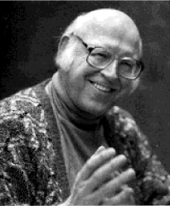
You can’t play Twenty Questions with Nature and win
Paper (1973) by Alan Newell. The title of the paper refers to a game
Newell argues psychologists study phenomena in detail, but forget the big picture

Slide 3
Newell’s solutions
Study large, real-life tasks, and find out all aspects of that task (example: chess)
Complete processing models: formal, computational models of human thinking
Newell: “The best theory of a phenomenon is a computer program that produces it”

Slide 4
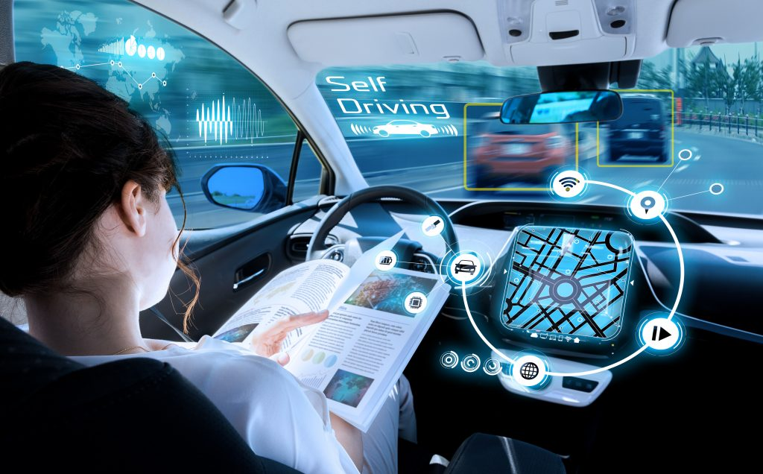
Possible models of driving a car

Slide 5
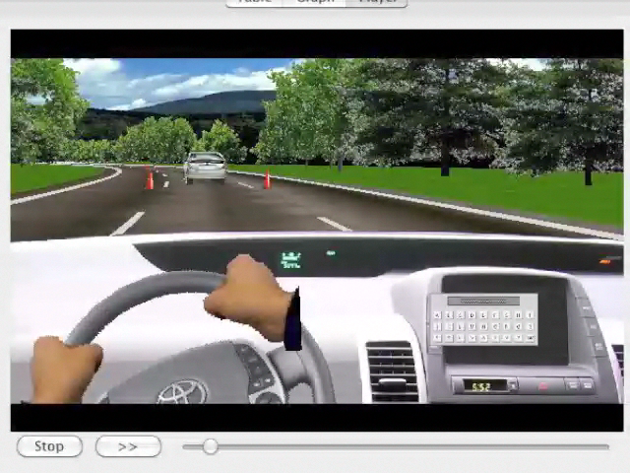

Slide 6
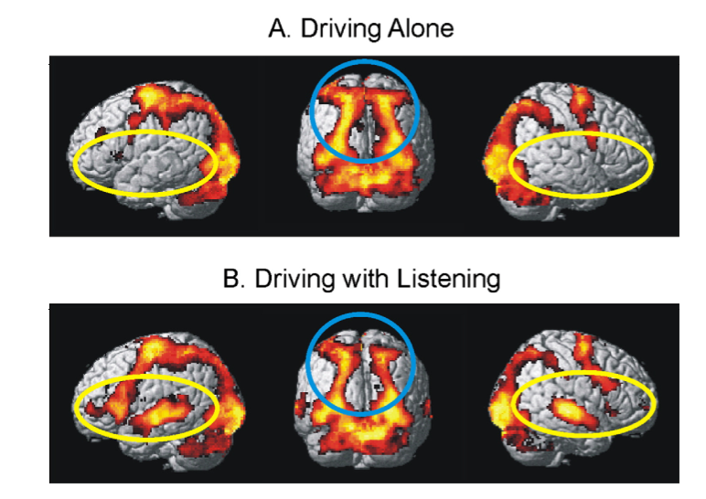
What is the best model of driving a car?

Slide 7
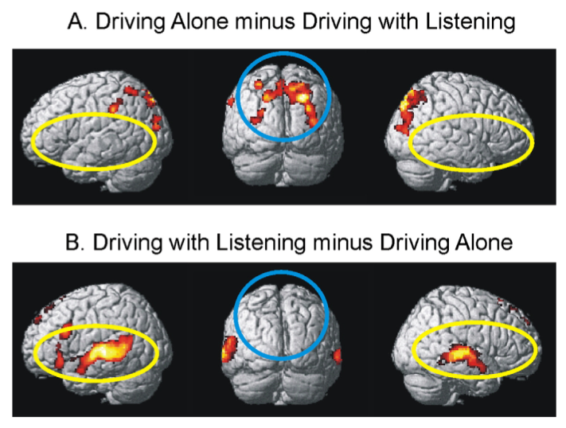
What is the best model of driving a car?

Slide 8
What makes a good model?
Functional criteria
The model has to be able to show intelligent behavior appropriate for the task
Behaviorial criteria
The model has to perform the task in the same way as humans
Neurophysiological criteria
The model has to be faithful to what happens in the brain
Use of neural networks or neural representations
Be able to predict brain activation

Slide 9
Architecture approach
Have a single formal theory to cover all aspects of cognition
Implement this theory as a simulation system
Build models to explain particular phenomena/experiments

Slide 10
Modular cognitive architectures
Algebra
Logical
Reasoning
Language
Learning
Decision
Making
Models
Attention
Time
Memory
Vision
...
Architecture

Slide 11
External World
ACT-R
Parse
3x-5=7
Type
x=4
Manual
Control
Visual
Perception
Production
System
Retrieve
7+5=12
Declarative
Memory
Problem State
Hold
3x=12
Control
State
“Unwinding”
“Retrieving”

Slide 12
External World
ACT-R
Parse
3x-5=7
Visual
Perception
Manual
Control
Visual
Cortex
Type
x=4
Motor
Cortex
Production
System
Basal
Ganglia
Declarative
Memory
Retrieve
7+5=12
Prefrontal
Cortex
Problem State
Parietal
Cortex
Hold
3x=12
Control
State
Anterior
Cingulate
“Unwinding”
“Retrieving”

Slide 13
Levels of abstraction for Cognition (Newell)
Time Units | System | World theory
Hours | Task
10 min | Task | Rational Band
minutes | Task
10 sec | Unit Task
1 sec | Operations | Cognitive Band
100 msec | Deliberate act
10 msec | Neural circuit | Biological Band
1 msec | Neuron

Slide 14
This course: two modules
Declarative Memory
Time perception
(Goal/WM module)
We will program (in Python) the behavior of the rest of the modules.

Slide 15
ACT-R declarative memory
Memory for facts, both semantic and episodic, e.g.
3+2=5
the past tense of go is went
Yesterday I had pizza for diner
The traffic light turns red after 15 pulses
Representation is similar to semantic networks (without inheritance)

Slide 16
ACT-R declarative memory
Chunks have an id and a number of attributes
Attributes point to other chunks
Example: 3+2=5 is represented as:
fact3+2 isa addition-fact addend1 three addend2 two sum five

Slide 17
ACT-R Declarative Memory
Chunks in memory have an activation value
Activation determines the priority of retrieval (highest activation is retrieved first)
If activation is below threshold, chunk cannot be retrieved
Activation determines retrieval time
Activation depends on:
How often chunk was retrieved in the past
Activation from the context

Slide 18
Sugar Factory Task (Berry & Broadbent, model by Wallach)
Participants have to achieve a certain goal output of a sugar factory by setting the number of workers for each day
The output is calculated on the basis of the number of workers and the output on the previous day, but the formula is unknown to participants

Slide 19
Sugar Factory details
Keep the production P of a simulated sugar factory at a target value T, by allocating an appropriate number of workers W to the job.
System dynamics are controlled by:
P_{t} = 2 W_{t} - P_{t-1} + Random Factor (-1/0/1)
Production depends on previous day
Random Factor makes it hard to find underlying rule

Slide 20
Sugar Factory task
Production 2
Workers 5
New Production 9
Production 2
Workers ?
Production 9
Workers ?
Goal Production = 9
Production 9
Workers 5
New Production 1
Production 1
Workers ?

Slide 21
Wallach’s model
Yesterday 2
Workers 7
Production 12
Yesterday 7
Workers ?
Goal Production 9
8
8
9
2
7
12
3
8
12
5
5
5
Declarative Memory

Slide 22
Results

Slide 23
Interval Timing

Slide 24
Interval timing is the capacity to estimate the duration of (short) intervals

Slide 25
It’s a type of “automatic” timing that is important for cognitive control, for decision making in faster paced tasks, for making inferences...
Interval timing is the capacity to estimate the duration of (short) intervals

Slide 26
“Unlike vision and audition, there are no dedicated sensors for time. Yet the passage of time is as perceptually salient as the color of an apple or the timbre of a tuba.” (Ivry 2004)
Interval timing is the capacity to estimate the duration of (short) intervals

Slide 27
Why bother with time?
Timing is automatic, and implicit.
Timing is implicit in many tasks / settings
Language:
Using pauses as a rhetorical tool.
Turn-taking in conversation.
Human-Environment Interaction:
Adapting to the pace of the environment.
Norman’s evaluation cycle.
Psychological Experiments

Slide 28
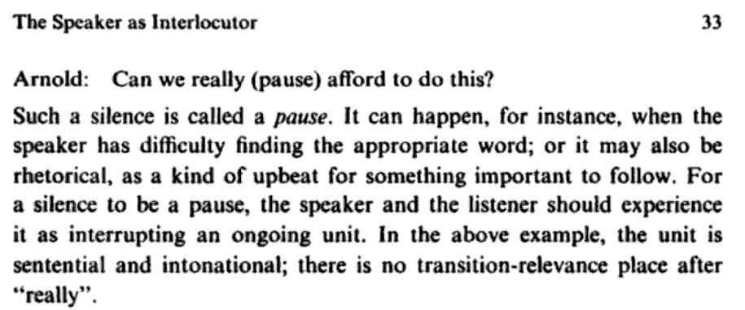

Levelt (1989) Speaking: From Intention to Articulation
Notes:
Timing as a rhetorical tool.

Slide 29
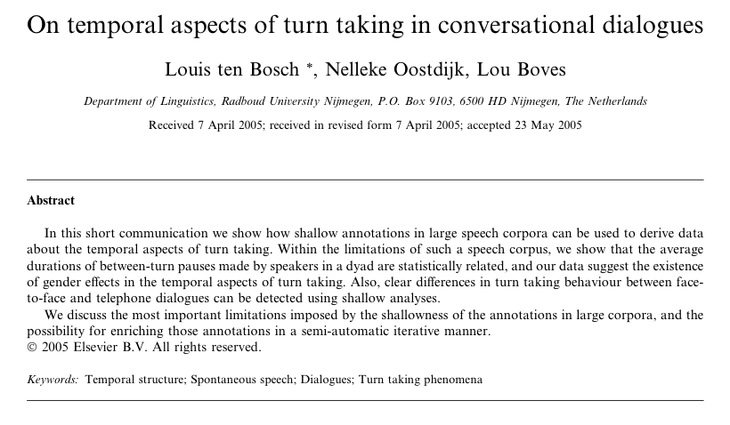
[W]e [..] derive data about the temporal aspects of turn taking. […] [W]e show that the average durations of between-turn pauses made by speakers in a dyad are statistically related […]. Also, clear diﬀerences in turn taking behaviour between face- to-face and telephone dialogues can be detected […].
Notes:
Pauses as turn-taking information.

Slide 30

Notes:
Norman’s evaluation cycle: delay between action and consequence.

Slide 32
Temporal Generalization

Slide 33

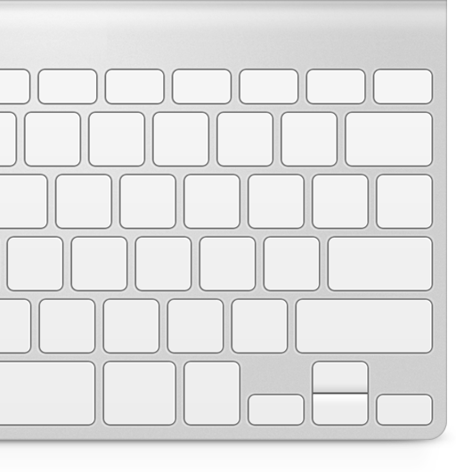

Slide 37
Red or Green
longer?

Slide 38
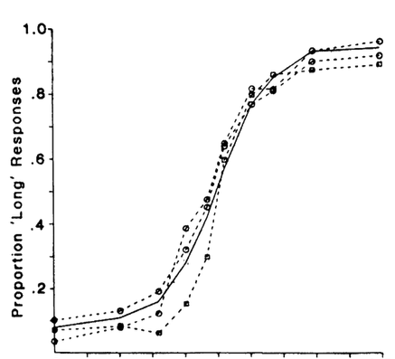
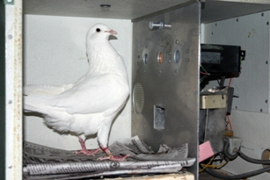
P(“Red longer”)
http://www.uky.edu/~zentall/recentpublication.html
Green longer
Equal
Red longer
Adapted from Heinemann (1984) Annals NY Academy of Sciences

Slide 39
Ready-Set-Go

Slide 40
Notes:
Temporal generalization

Slide 47
Reproduction

Slide 53
Correct!
Too fast!
Too slow!

Slide 54
Results: Scalar Property

Slide 55
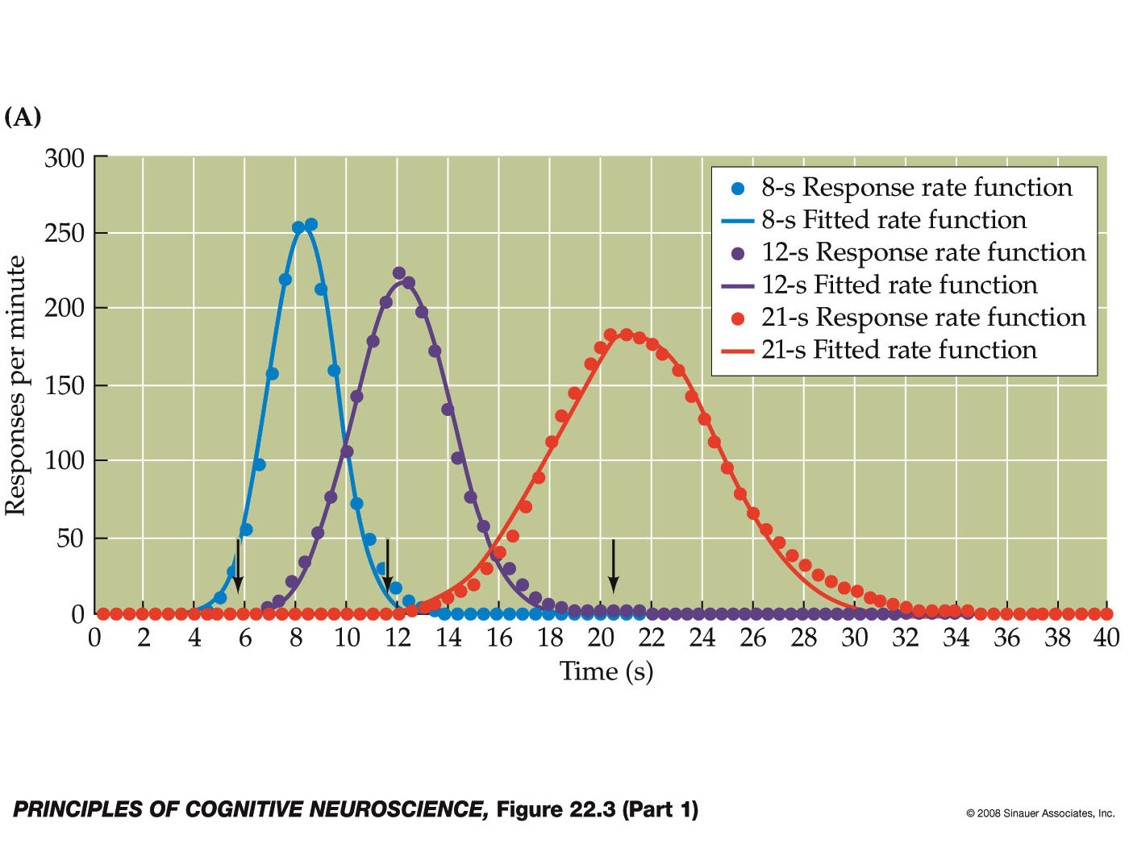
Peak Procedure

Slide 56
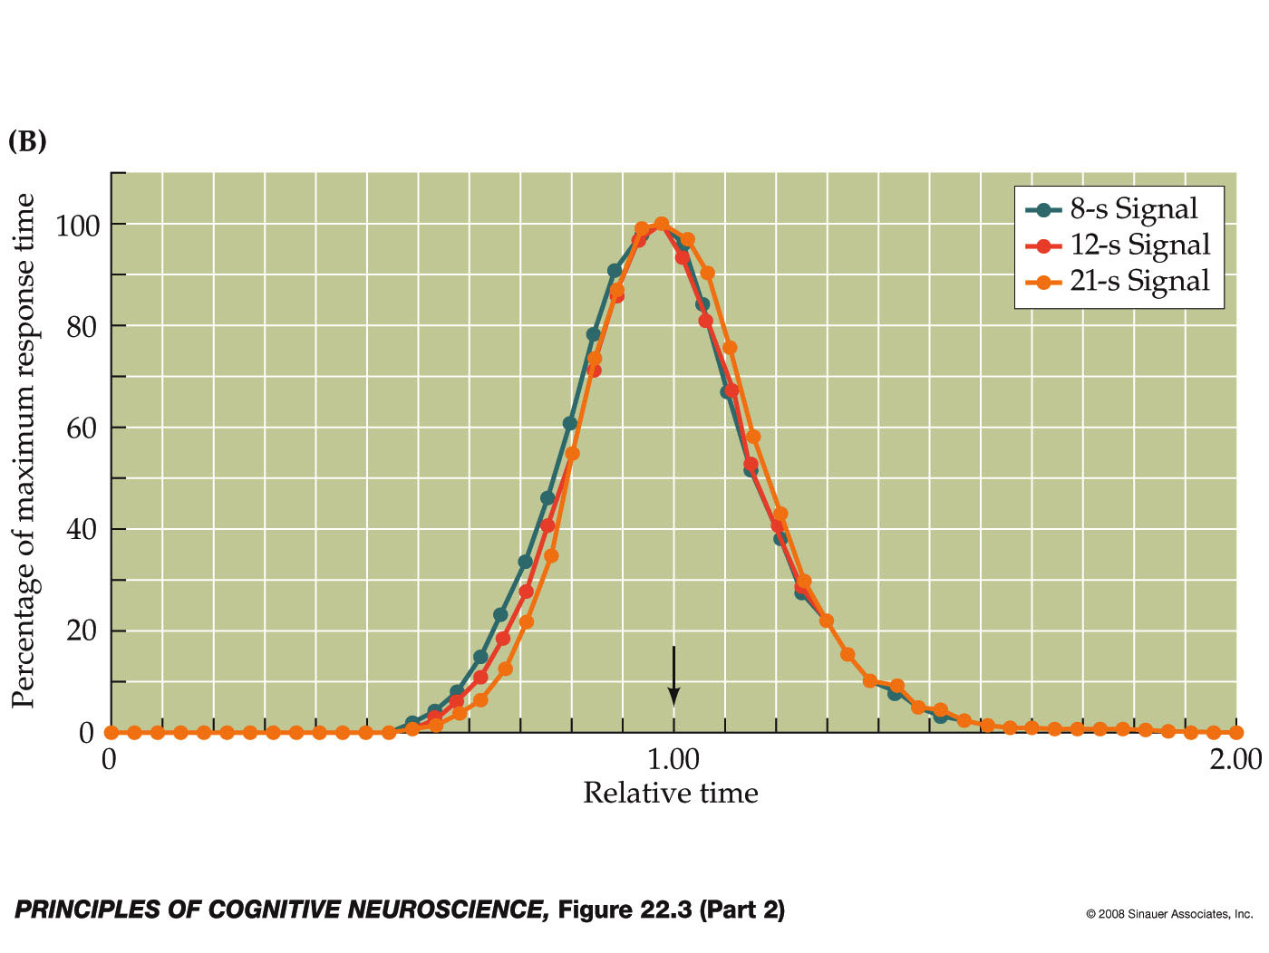
Scalar Property

Slide 57
What drives interval timing?

Slide 58
Human Interval Timing
150 years ago:
Von Baer (1860, perceptual moment), Mach (1865, Weber’s law), Donders (1868, chronometry), Vierordt (1868)
75 years ago:
Rats and pigeons in behaviorist experiments
50 - 25 years ago:
1960s-1980s: Information processing models (e.g., Michon, 1967: “Formal lay-out of ‘time sense’ underlying most historical theories”)
Recent revival, both behavioral and neuroscience based.

Slide 59
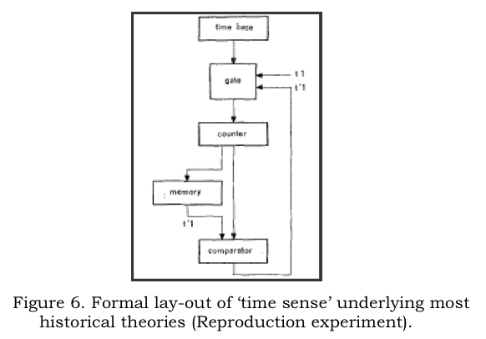
Information Processing Approaches to Interval Timing
(e.g., Creelman, 1962, Michon, 1967, Gibbon, 1977, Treisman, 1963)
Notes:
Temporal behavioral requires more than “just time”, it has to be embedded in a broader cognitive system.
“Modified church and gibbon model”

Slide 60
IP Models of Interval Timing
(e.g., Creelman, 1962, Michon, 1967, Gibbon, 1977, Treisman, 1963, etc)

Slide 61
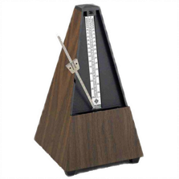


Scalar Timing Theory

Slide 62

Scalar Timing Theory
2
4
1
3
Notes:
Red or green (left or right) longer on the screen?

Slide 63
Scalar Timing Theory
2
1
3
4
Notes:
It could be, of course, that instead of a perfect match, an “close match” would have been sufficient to trigger the “same” response.

Slide 64
Scalar Timing Theory
3
4
Green or Red?
Red
Notes:
It could be, of course, that instead of a perfect match, an “close match” would have been sufficient to trigger the “same” response. But what determines whether a match is “close”? Well, these types of models don’t provide us with an answer…

Slide 65
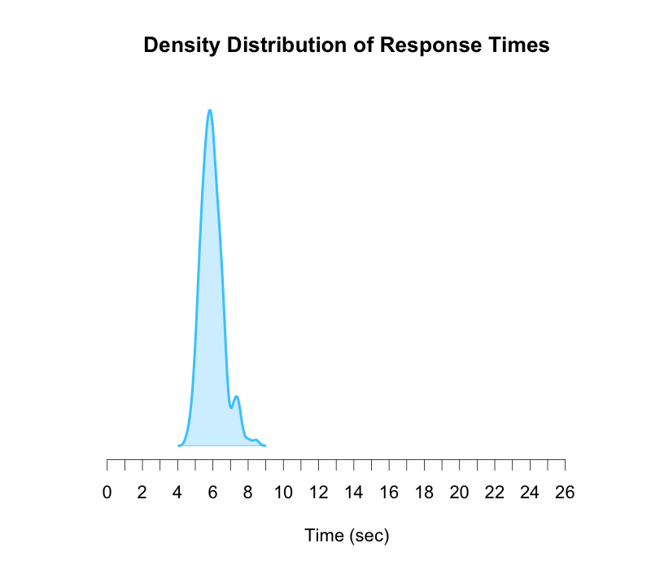
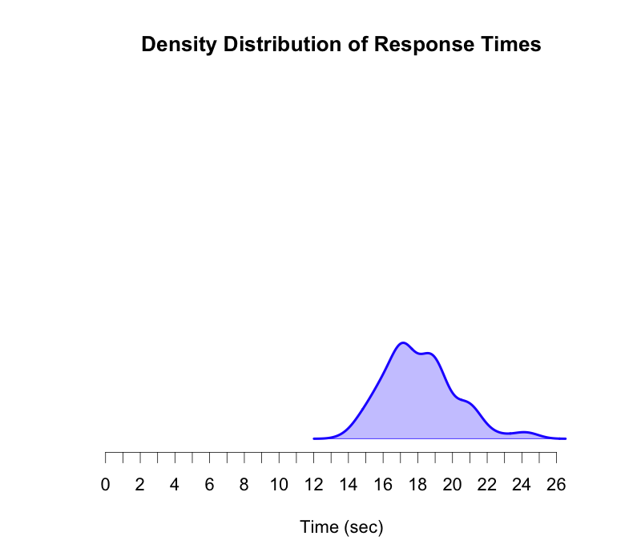
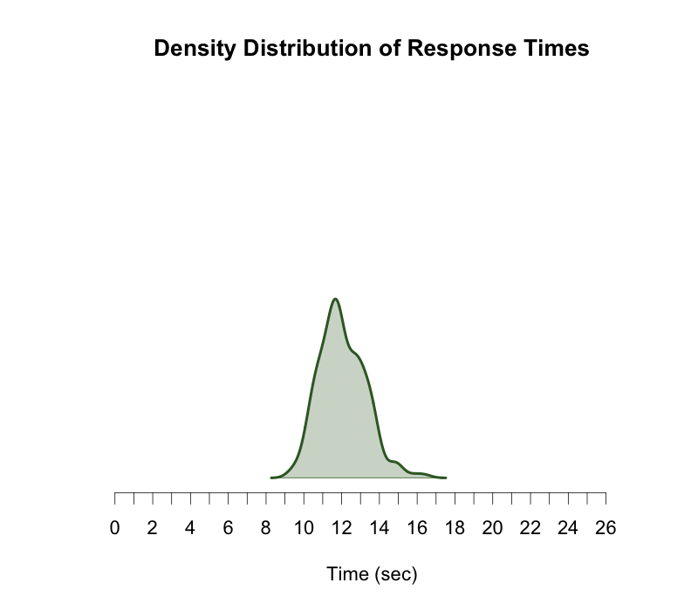
Model trained
at 6s
Model trained
at 12s
Model trained
at 18s
cf. Matell & Meck (2004)

Slide 66
IP Models of Interval Timing
Notes:
It could be, of course, that instead of a perfect match, an “close match” would have been sufficient to trigger the “same” response. But what determines whether a match is “close”? Well, these types of models don’t provide us with an answer…

Slide 67
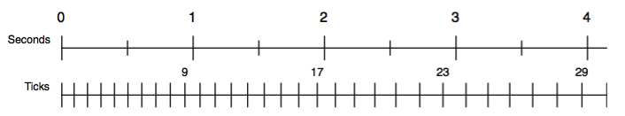
Timing in ACT-R
Idea: Metronome that starts ticking fast, but gradually slows down
The current value of the accumulator is available to the rest of cognition
At any moment, the accumulator can be read or matched in the condition of a production

Slide 68
Stochastic Process
t₀ = length of starting pulse
t_{n+1}= a x t_{n} + noise(M=0, SD=b x a x t_{n})
Noise = logistic noise (ACT-R default, normal-like)
Two sets of parameters:
t₀ = 11 ms, a = 1.1, b = 0.015 t₀ = 100 ms, a = 1.02, b = 0.015

Slide 69
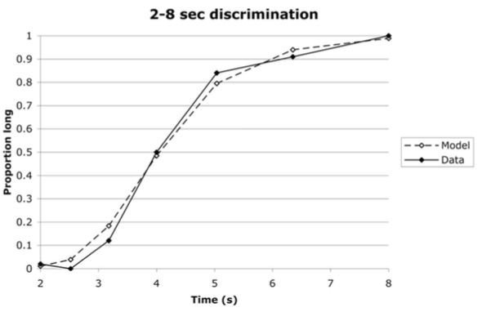
Bisection

